Slide 1
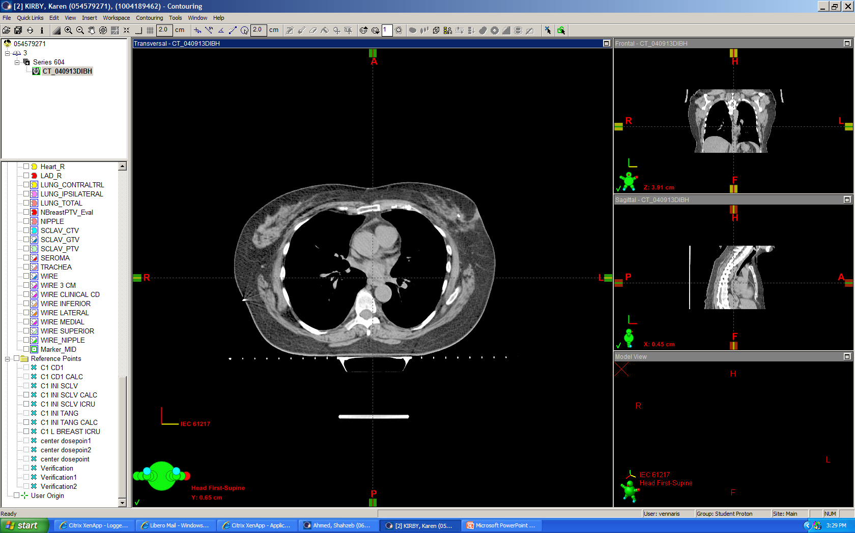
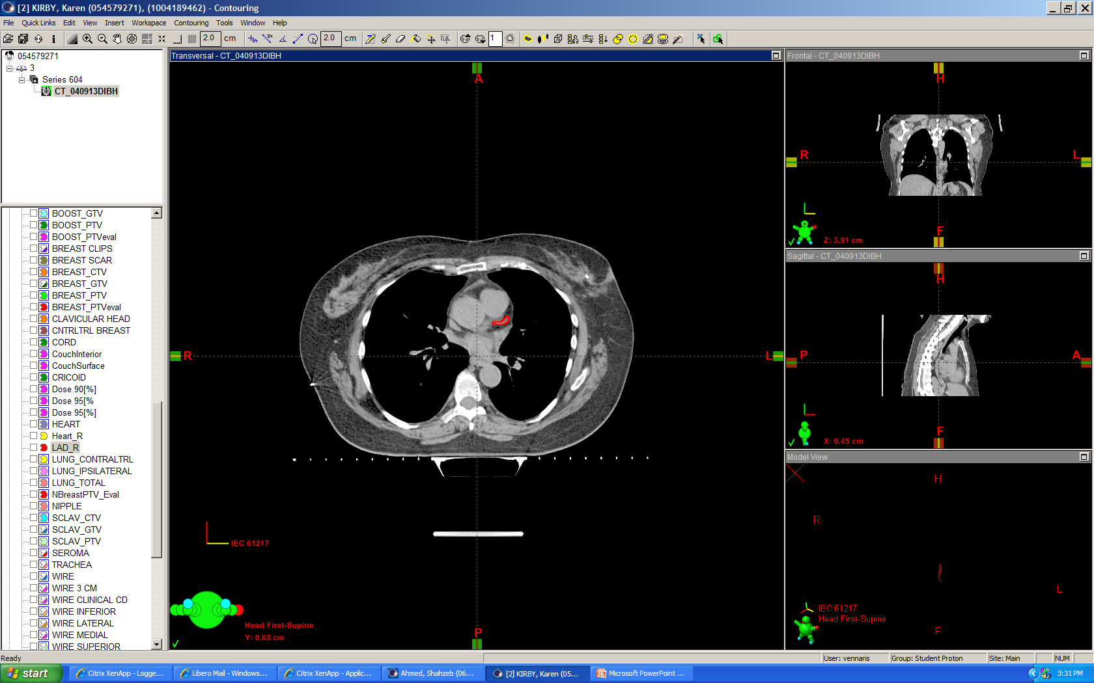
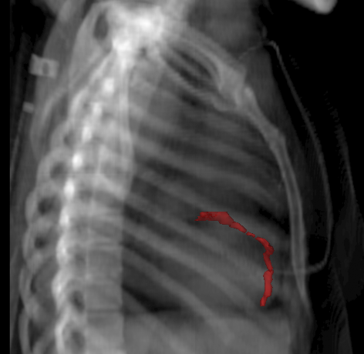
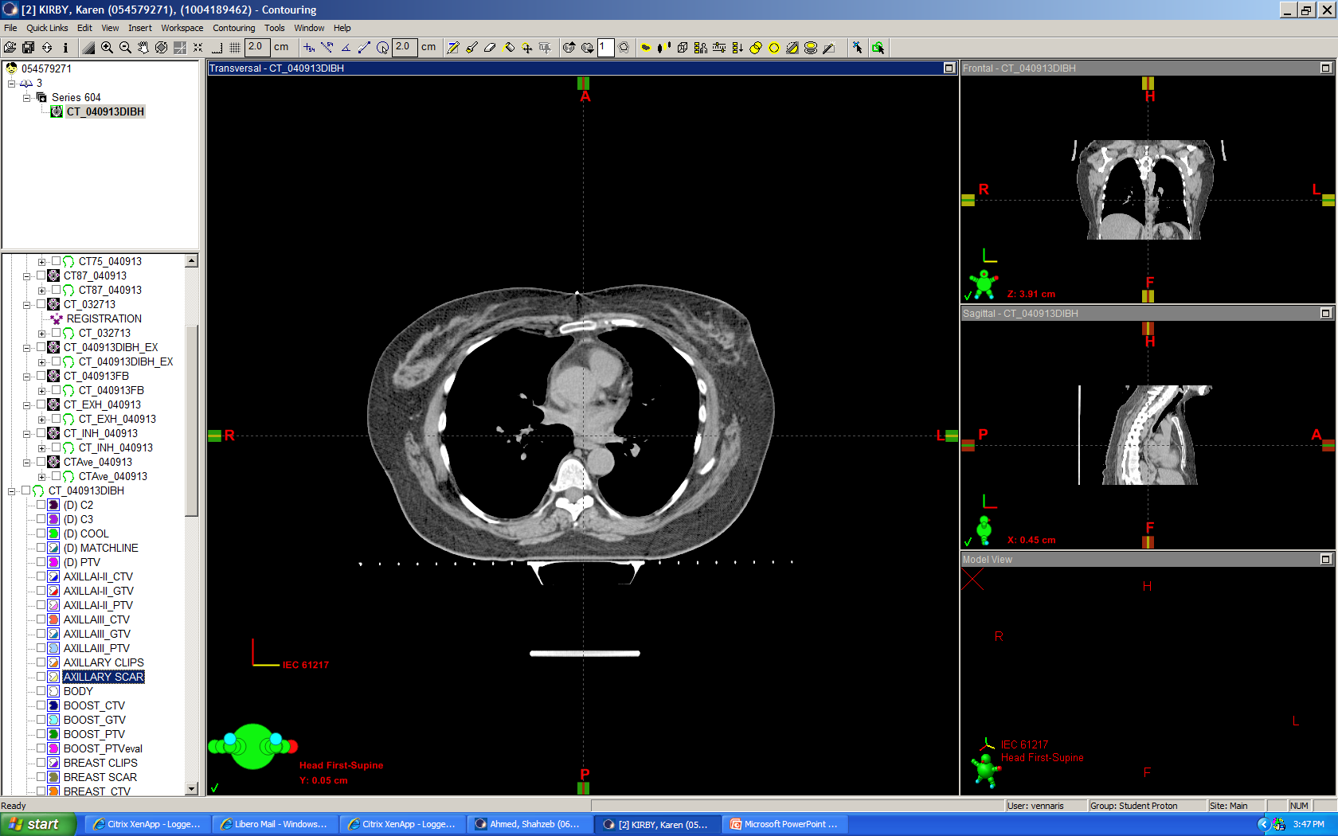

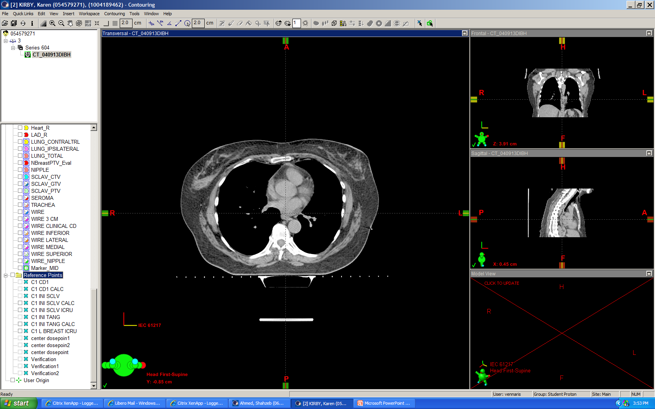
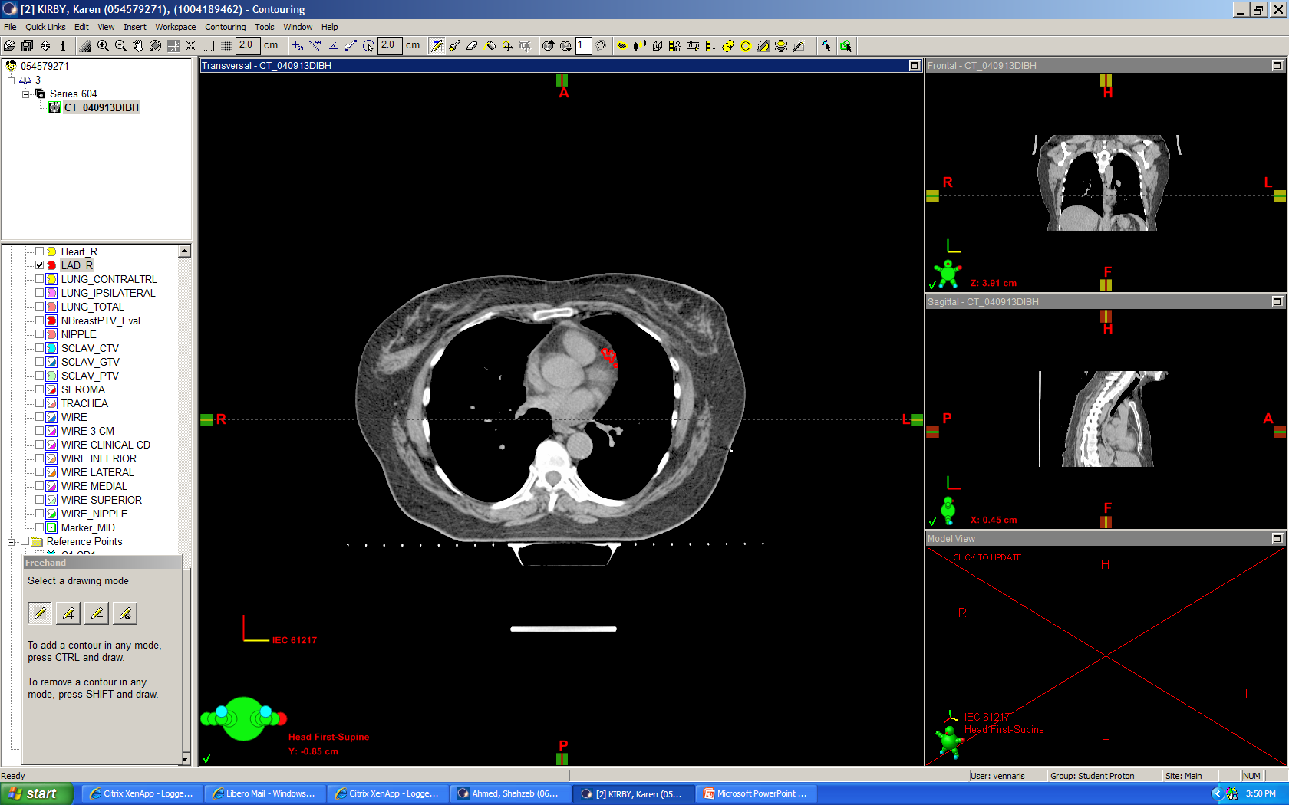
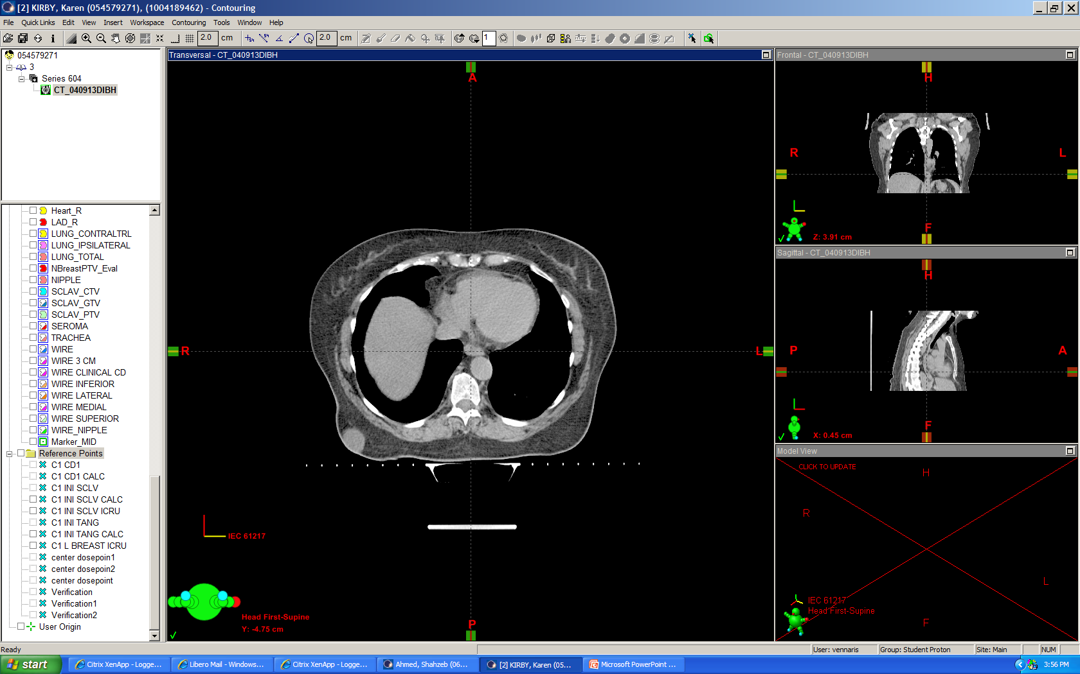

Supplementary Figure 1
A B.
C.
Notes:
Supplementary Figure 1. Contour of LAD. A) axial slice of heart without contrast enhancement, B) axial slice of heart with LAD contour, C) contour of LAD represented on digital reconstructed radiograph.

Slide 2
Supplementary Table I. Target and normal organ volumes from 10 patients with left-sided breast cancer.
 | PTV | Heart | Lungs | LAD
Maximum volume (cm³) | 1775.7 | 802.7 | 2442.2 | 3.1
Minimum volume (cm³) | 292.2 | 342.4 | 1626.1 | 0.9
Average volume (cm³) | 877.8 | 612.8 | 2012.8 | 2.0
Standard deviation (cm³) | 440.3 | 130.0 | 266.7 | 0.7

